Slide 1


Rust 初探II
Rust Current Version: 1.54.0 (a178d0322 2021-07-26)
冯濒啸
https://github.com/rust-lang/rust

Slide 2
Referennce
CIS198
The Book
RustMagazine 中文月刊
Rust for C++ Programmers
《Rust编程之道》
《The Rust Programming Language》
《Hands-on data structures and algorithms with Rust》

Slide 3
ToolChain
Rust>=1.52 (Rustc, Rustup, Cargo)
VSCode + rust-analyzer (Python Github Copliot)
Excalidraw/draw.io
Rust search extension

Slide 4
Motivation
Safe
Fast (C++, Go)
Wasm
足够底层，跨平台
社区强大，几乎啥都能干了
装X（周围的人不懂）

Slide 5
Hello World
Install
main.rs
$ rustc main.rs
$ ./main
Hello, world!
fn main() {
println!("Hello, world!");
}

Slide 6
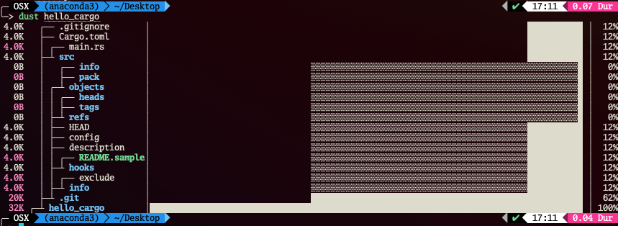
Hello, Cargo!
[package]
name = "hello_cargo"
version = "0.1.0"
authors = ["Your Name <you@example.com>"]
edition = ”2021"
[dependencies]
$ cargo new hello_cargo
$ cd hello_cargo
Cargo.toml
src/main.rs
fn main() {
println!("Hello, world!");
}
the edition of Rust to use, Ex.:
2015 -> v1.0
2018 -> v1.31
2021 -> v1.51-1.54
每三年一大版，“三年Fungi”
$ cargo build
Compiling hello_cargo v0.1.0 (file:///projects/hello_cargo) Finished dev [unoptimized + debuginfo] target(s) in 2.85 secs
$ ./target/debug/hello_cargo # or .\target\debug\hello_cargo.exe on Windows Hello, world!
Notes:
https://doc.rust-lang.org/cargo/index.html

Slide 7
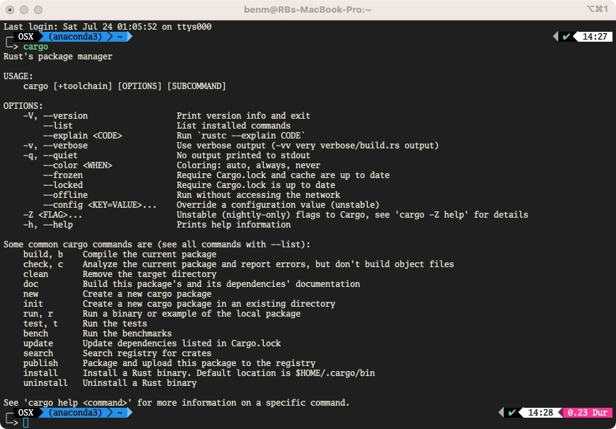
Cargo

Slide 8
Trade-offs in programming languages （Design Philosophy）
Approachability（可实现性）
Availability （可用性）
Compatibility （兼容性）
Composability （可组合性）
Debuggability （可调试性）
Expressiveness （可表达性）
Extensibility （可扩展性）
Interoperability （互动性）
Integrity （集成力）
Maintainability （可维护性）
Measurability （可测量性）
Operability （可操作性）
Performance （性能）
Portability （便携性）
Productivity （生产力）
Resiliency （弹性）
Rigor （严谨性）
Safety （编译运行安全性）
Security （攻防安全性）
Simplicity （简单）
Stability （稳定性）
Thoroughness （彻底性）
Transparent （透明性）
Velocity （速度）

Slide 9
C
Approachability
Availability
Compatibility
Composability
Debuggability
Expressiveness
Extensibility
Interoperability
Integrity
Maintainability
Measurability
Operability
Performance
Portability
Productivity
Resiliency
Rigor
Safety
Security
Simplicity
Stability
Thoroughness
Transparent
Velocity

Slide 10
Erlang/Elixir
Approachability
Availability
Compatibility
Composability
Debuggability
Expressiveness
Extensibility
Interoperability
Integrity
Maintainability
Measurability
Operability
Performance
Portability
Productivity
Resiliency
Rigor
Safety
Security
Simplicity
Stability
Thoroughness
Transparent
Velocity

Slide 11
Python
Approachability
Availability
Compatibility
Composability
Debuggability
Expressiveness
Extensibility
Interoperability
Integrity
Maintainability
Measurability
Operability
Performance
Portability
Productivity
Resiliency
Rigor
Safety
Security
Simplicity
Stability
Thoroughness
Transparent
Velocity

Slide 12
Java (in early days)
Approachability
Availability
Compatibility
Composability
Debuggability
Expressiveness
Extensibility
Interoperability
Integrity
Maintainability
Measurability
Operability
Performance
Portability
Productivity
Resiliency
Rigor
Safety (memory)
Security
Simplicity
Stability
Thoroughness
Transparent
Velocity

Slide 13
Rust
Approachability
Availability
Compatibility
Composability
Debuggability
Expressiveness
Extensibility
Interoperability
Integrity
Maintainability
Measurability
Operability
Performance
Portability
Productivity
Resiliency
Rigor
Safety!!!
Security
Simplicity
Stability
Thoroughness
Transparent
Velocity

Slide 14
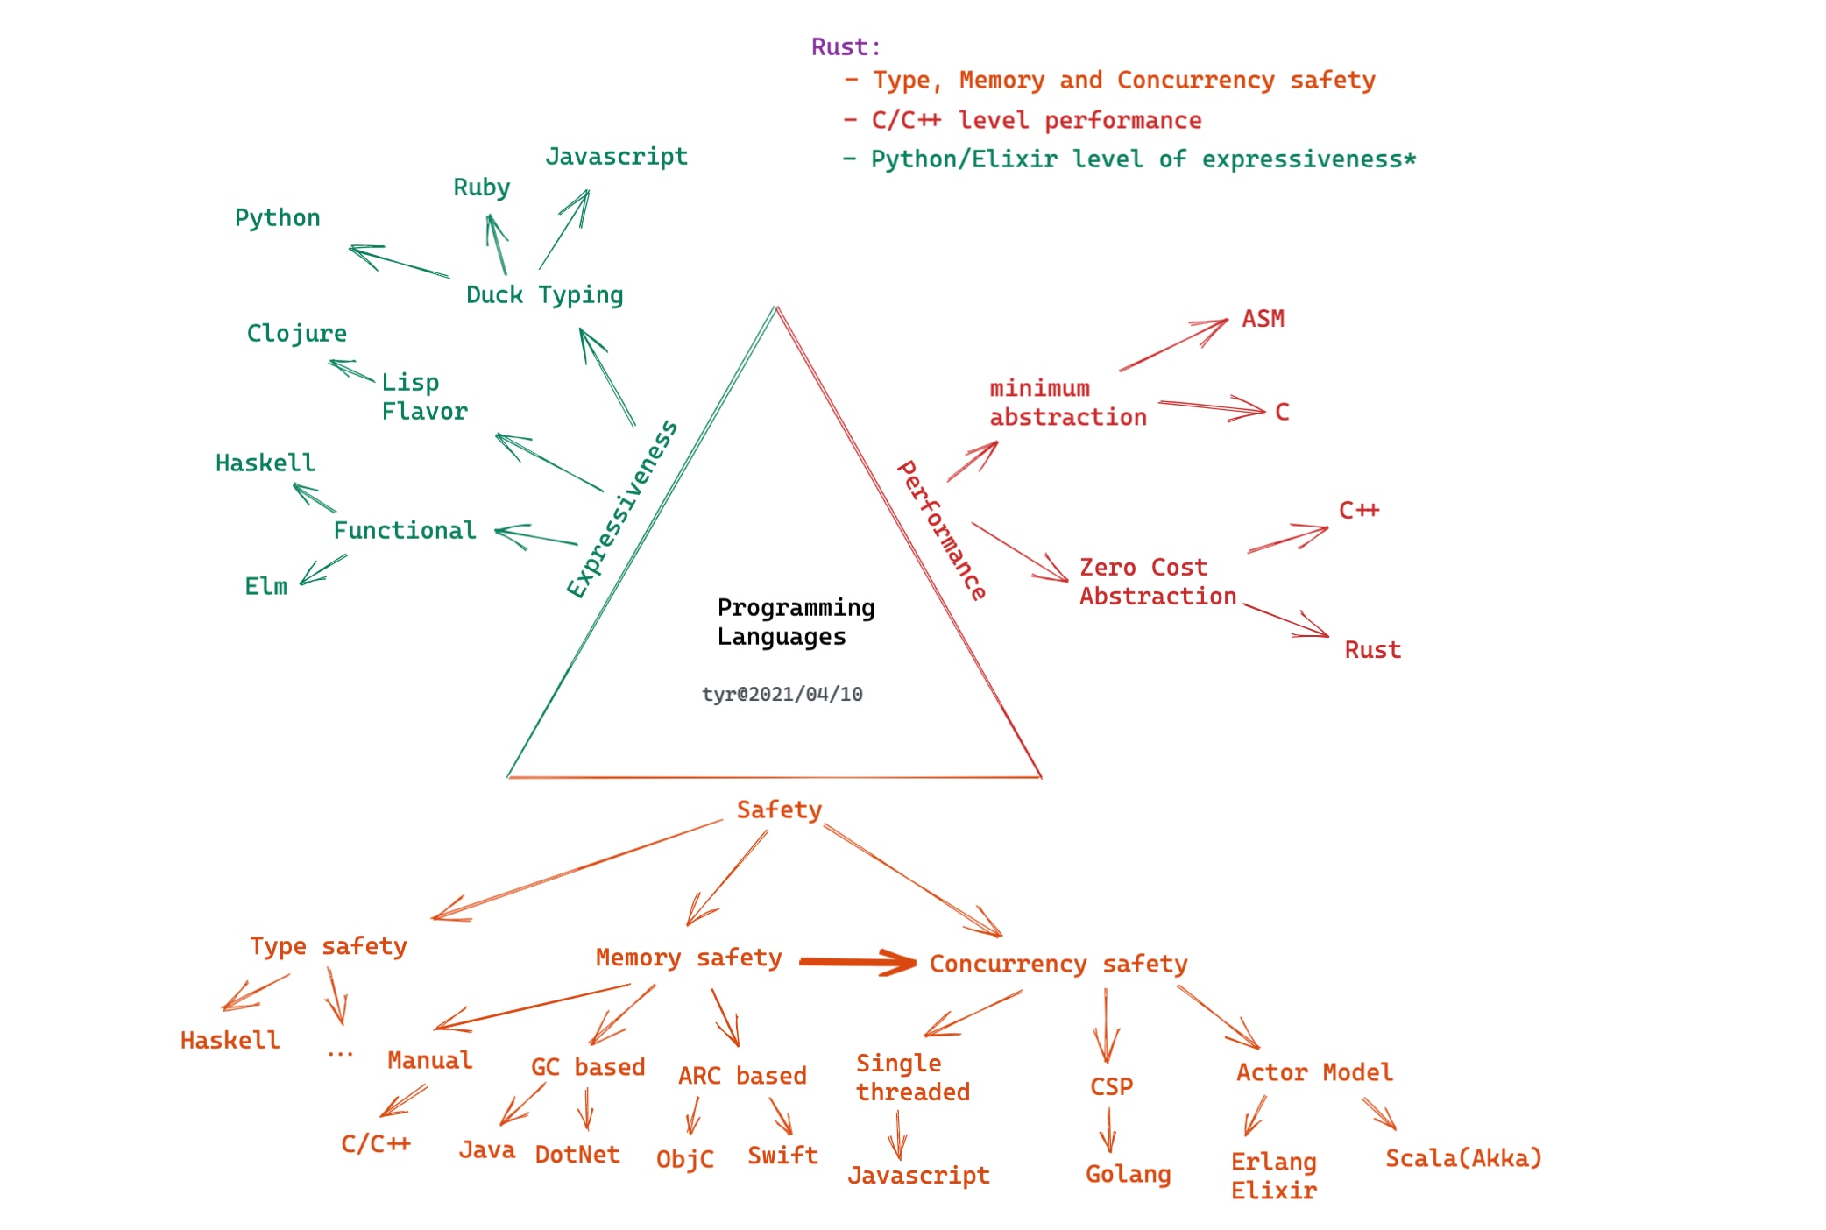
Programming Languages Gloden Triangle

Slide 15
内存安全
Heap
Stack
RAII

Slide 16
UnSafe Rust
隐藏着第二个语言，没有强制内存安全保证: Unsafe Rust
Unsafe Rust存在的原因
静态分析是保守的
使用Unsafe Rust：我知道自己在做什么，并承担相应风险
计算机硬件本身就是不安全的，Rust需要能够进行底层系统编程

Slide 17
Unsafe超能力
使用unsafe关键字来切换到unsafe Rust，开启一个块，里面放着unsafe代码
Unsafe Rust里可执行的四个动作：
解引用原始指针
调用unsafe函数或方法
访问或个性可变的静态变量
实现unsafe trait
//注意：
- unsafe并没有关闭借用检查或停用其它安全检查
- 任何内存安全相关的错误必须留在unsafe块里
- 尽可能隔离unsafe代码，最好将其封装在安全的抽象里，提供安全的API

Slide 18
Rust Thrift RPC
http://10.0.32.42:4480/fengbinxiao/rust_learning/tree/master/thrift_rs_example

